Slide 1
Data Presentation
Business Intelligence for Marketing Optimization: A SQL, Python & Power BI Approach
~ By Zodrick John (UE223115) | UIET, Panjab University

Slide 2
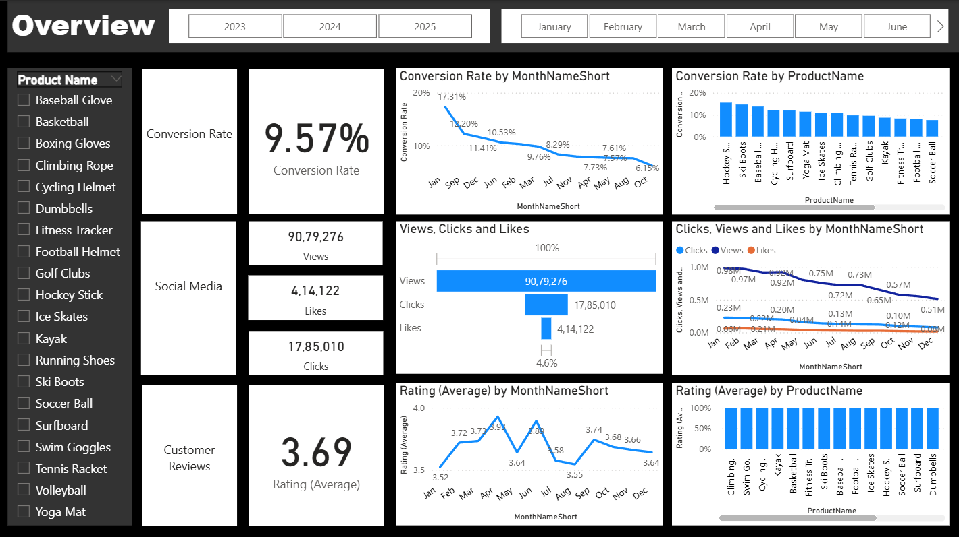
Overview
The marketing analytics dashboard provides a comprehensive view of conversion rates, customer engagement, and customer feedback for ABC’s online retail business.
Conversion Rates: The overall conversion rate stands at 9.57%, with fluctuations throughout the year. The lowest point was 5.0% in October, while December showed a rebound to 10.2%, indicating strong seasonal recovery.
Customer Engagement: Social media engagement has declined steadily, with total views reaching 90.8 million, clicks at 1.78 million, and likes at 0.41 million. Although the overall engagement is low compared to views, the click-through rate (CTR) of 15.37% highlights that engaged users remain highly interactive.
Customer Feedback: Customer ratings have remained consistent at an average of 3.7, slightly below the target benchmark of 4.0. Certain products scored below 3.5, signaling the need for focused improvements in customer satisfaction and product quality.
Overall, the analysis identifies decreased conversion rates, reduced engagement, and below-target feedback scores as the major challenges, while also highlighting opportunities for improvement through data-driven marketing strategies.

Slide 3
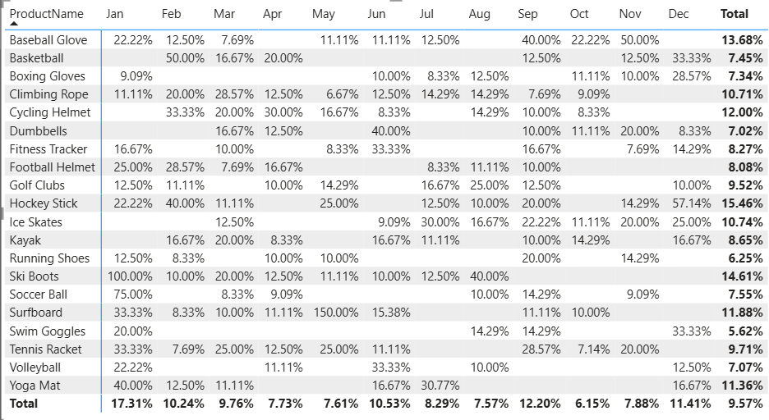
Decreased Conversion Rates
General Conversion Trend:
Throughout the year, conversion rates show significant variation, strongly suggesting that product performance is tied to seasonal demand. Peak conversion months like January, September, and December align with popular sports seasons, while lower-performing months present an opportunity for targeted marketing interventions.
Lowest Conversion Month:
October experienced the lowest overall conversion rate at 6.15%. This dip indicates a potential need for strategic promotions or off-season marketing campaigns to stimulate demand and improve performance during this period.
Highest Conversion Rates:
January recorded the highest overall monthly conversion rate at 17.31%, largely driven by winter sports equipment. Ski Boots stood out with a perfect 100% conversion rate.
The single most remarkable performance was from the Surfboard in June, which achieved an exceptional 150% conversion, highlighting a powerful combination of seasonal demand and effective marketing.

Slide 4
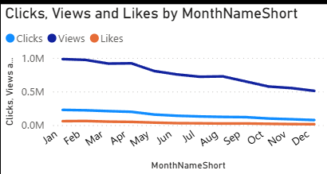
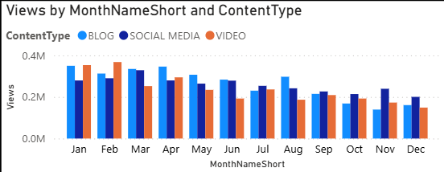
Reduced Customer Engagement
Declining Views:
Views peaked at the start of the year in January and February at approximately 1.0M and showed a consistent, gradual decline throughout the year, indicating a sustained drop in audience engagement.
Low Interaction Rates:
Clicks and Likes remained significantly lower than Views across the entire year. This large gap suggests that while content is being seen, it is not effectively driving user interaction, highlighting a need for more compelling content or clearer calls-to-action.
Content Type Performance:
Performance across the three content types was highly competitive, with the leading format changing from month to month. Video and Social Media content drove the most views in the first quarter, while Blog content was the strongest performer through the middle of the year.

Slide 5
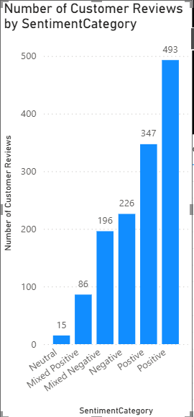
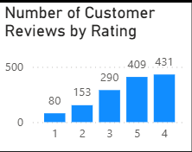
Customer Feedback Analysis
Customer Ratings Distribution:
The majority of customer reviews are in the higher ratings, with 431 reviews at 4 stars and 409 reviews at 5 stars, indicating overwhelmingly positive feedback. Lower ratings (1-3 stars) account for a smaller, yet significant, portion of the reviews, with 290 reviews at 3 stars being the most common in this group.
Sentiment Analysis:
Positive sentiment dominates with a total of 840 reviews, reflecting a generally satisfied customer base. Negative sentiment is present in 226 reviews, with a notable number of Mixed Negative (196) reviews, suggesting specific areas for improvement despite overall strong customer approval.
Opportunity for Improvement:
The presence of 196 Mixed Negative and 86 Mixed Positive reviews suggests there is a key opportunity to convert these nuanced experiences into more decisively positive ones. Addressing the specific concerns mentioned in these mixed reviews could elevate overall customer satisfaction.

Slide 6
Goals & Actions
Goals
Actions
Increase Conversion Rates
Identify factors impacting the overall 9.57% conversion rate and provide recommendations to improve it.
Analyze the causes behind the lowest conversion month, October (6.15%), and replicate the success of peak months like January (17.31%).
Enhance Customer Engagement
Determine the key drivers behind the consistent, year-long decline in views, which peaked in January/February at 1.0M and fell throughout the year.
Address the low interaction rates, where clicks and likes remain significantly lower than views, indicating a need for more compelling content.
Improve Customer Feedback Scores
Understand the common themes in customer reviews to raise the average rating from 3.69 to the company benchmark of 4.0.
Identify and analyze recurring issues from the 226 negative and 196 mixed-negative reviews to guide product and service improvements.
Increase Conversion Rates
Target High-Performing Product Categories: Focus marketing efforts on products with demonstrated high conversion rates, such as Hockey Stick (15.46%), Ski Boots (14.61%), and Baseball Glove (13.68%).
Implement Seasonal Promotions: Capitalize on seasonal trends by promoting winter sports in peak months like January (when Ski Boots had a 100% conversion rate) and summer items like Surfboards in June (150% conversion rate).
Enhance Customer Engagement
Reverse Engagement Decline: To counter the steady decline in views, experiment with more engaging content formats and implement stronger, clearer calls-to-action.
Optimize Content Strategy: Develop a dynamic content calendar based on past performance, leveraging Video and Social Media in the first quarter and Blog content in the middle of the year, where they showed the strongest performance.
Improve Customer Feedback Scores
Address Mixed and Negative Feedback: Implement a feedback loop where the 226 negative and 196 mixed-negative reviews are systematically analyzed to identify common issues.
Develop Improvement Plans: Create and execute action plans that directly address the concerns raised in customer feedback, with the goal of elevating the average product ratings closer to the 4.0 target.

